Slide 1



Employee Salary Analysis
Key Performance Indicators and Analytical Insights

Slide 2


Agenda
INTRODUCTION
INSIGHT
SUMMARY
CONCLUSION

Slide 3
Introduction
Overview of the analysis conducted on employee salaries across different job roles.
Objective :- To understand salary distribution and key factors influencing compensation across various roles and company locations.
Highlight the use of filters for year, experience level, and company size to refine the analysis.

Slide 4
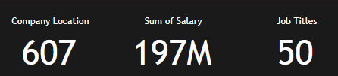
Key Performance Indicators
Total Company Locations :- 607
Sum of Salaries :- 197 million
Total Job Titles :- 50

Slide 5
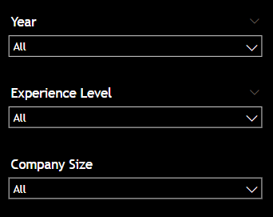
Filters Applied
Year :- Analysis based on the selected year(s).
Experience Level :- Analysis categorized by different experience levels (Entry, Mid, Senior, Experienced).
Company Size :- Analysis segmented by company size (Small, Medium, Large).

Slide 6
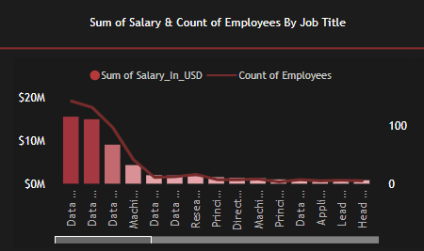
Sum of Salaries and Count of Employees by Job Title
Chart Description :- Bar chart showing the sum of salaries and count of employees for each job title.
Insight :-
* Highest sum of salaries :- Data Scientist
* Followed by :- Data Engineer, Data Analyst, Machine Learning Engineer

Slide 7
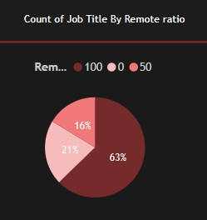
Count of Job Titles by Remote Ratio
Chart Description :- Pie chart showing the count of job titles based on remote work ratio.
Insight :-
* 100% remote :- 381 job titles
* 50% remote :- 99 job titles
* 0% remote :- 127 job titles

Slide 8
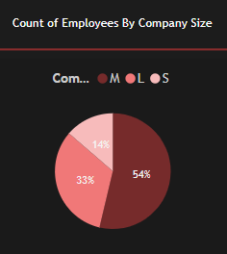
Count of Employees by Company Size
Chart Description :- Pie chart illustrating the number of employees categorized by company size.
Insight :-
* Medium-sized companies :- 326 employees
* Large companies :- 198 employees
* Small companies :- 83 employees

Slide 9
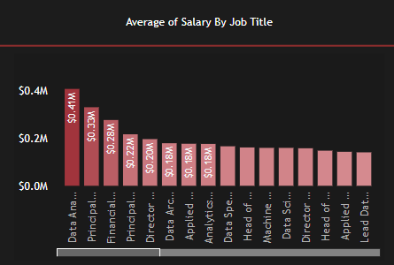
Average Salary by Job Title
Chart Description :- Bar chart showing the average salary for each job title.
Insight :-
* Highest average salary :- Data Analytics Lead ($0.41 million)
* Followed by :- Principal Data Engineer ($0.33 million), Financial Data Analyst ($0.328 million)

Slide 10
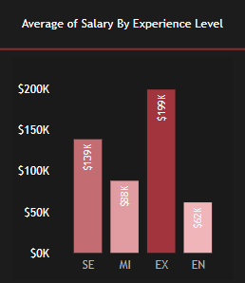
Average Salary by Experience Level
Chart Description :- Bar chart showing the average salary for different experience levels.
Insight :-
* Experienced :- $199K
* Senior :- $139K
* Mid-level :- $88K
* Entry-level :- $62K

Slide 11
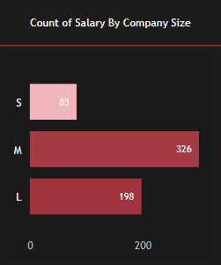
Count of Salaries by Company Size
Chart Description :- Bar chart showing the count of salaries by company size.
Insight :-
* Small companies :- 83 salaries
* Medium companies :- 326 salaries
* Large companies :- 198 salaries

Slide 12
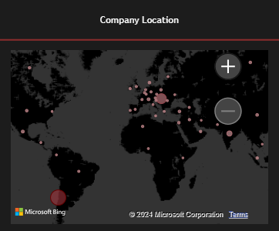
Average Salary by Company Location
Chart Description :- Map chart showing average salary for each company location.
Insight :- Visualization of geographical salary distribution across different locations.

Slide 13
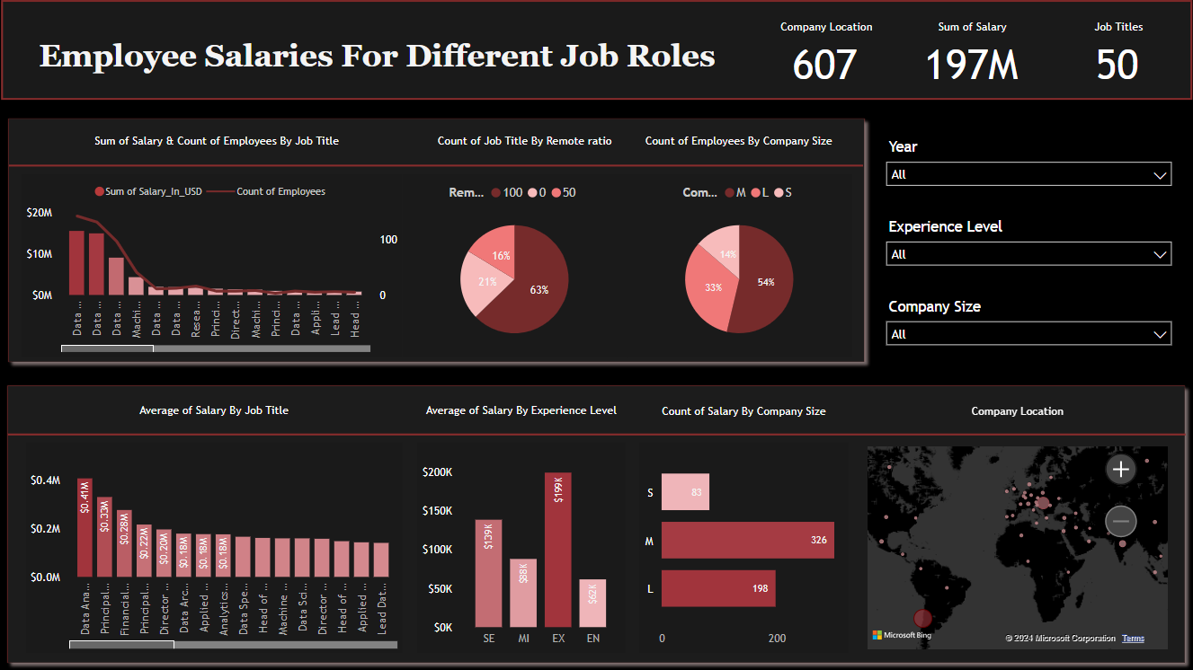
Dashboard

Slide 14
Summary of Insights
Key KPIs :-
* Total Company Locations :- 607
* Sum of Salaries :- 197 million
* Total Job Titles :- 50
Major Findings :-
* Data Scientist has the highest sum of salaries.
* Most common remote work arrangement is 100% remote.
* Medium-sized companies employ the most employees.
* Highest average salary is for the Data Analytics Lead role.
* Salary increases with experience level.

Slide 15
Conclusion
Recap of key insights and KPIs.
Insights into trends affecting salary distribution across different job roles and company locations.
Considerations for workforce planning and budgeting.
Potential areas for further research or deeper analysis to uncover more insights.

Slide 16
THANK YOU

